Slide 1
INTRO MICROSOFT EXCEL & GOOGLE SHEETS
Eastern Monroe Public Library

Slide 2
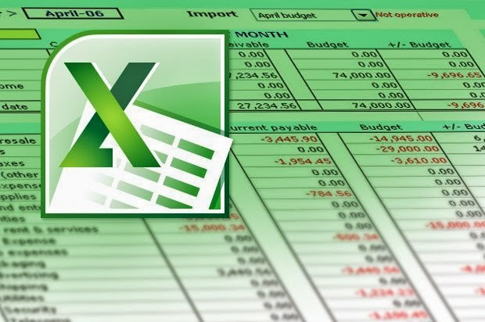
Excel: #1 Spreadsheet Program

Slide 3
Why we use Spreadsheets
Create organized lists with large amounts of data
Sort text data
Calculate numeric data
Perform “what-if” calculations without changing the underlying data

Slide 4
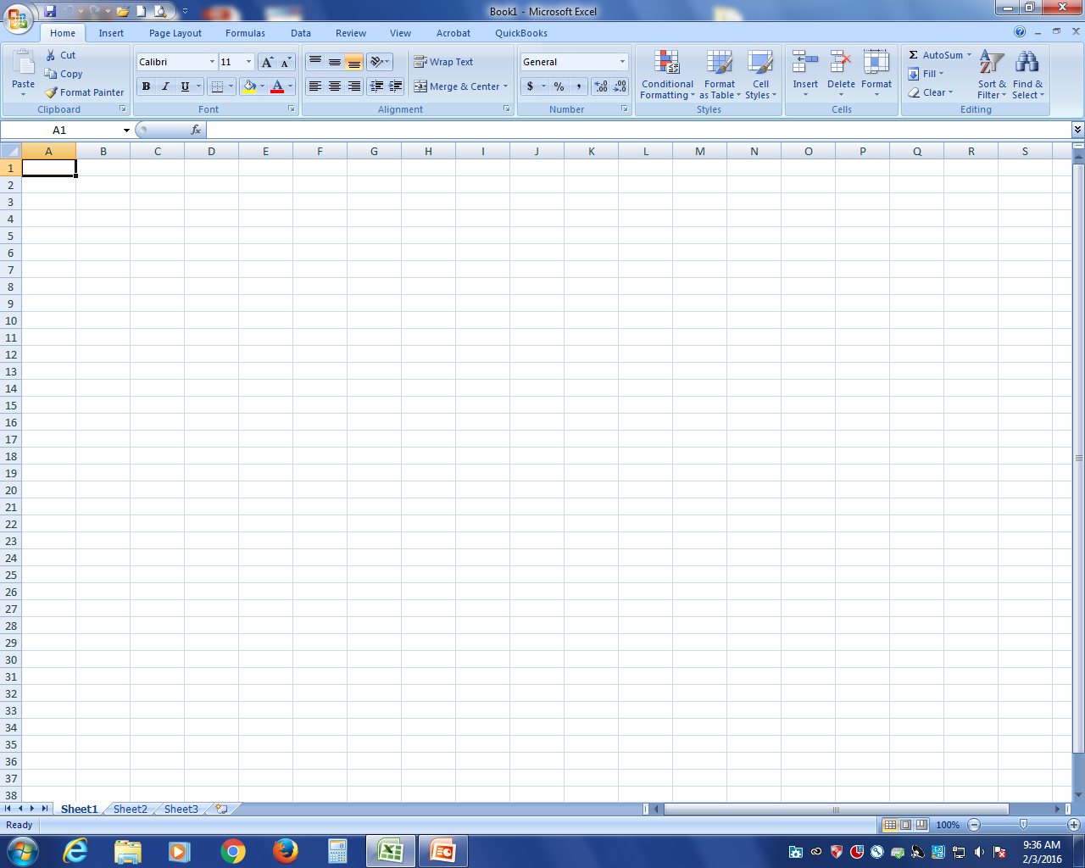

Slide 5
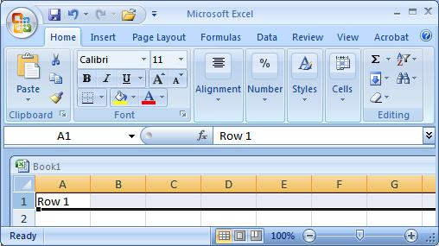
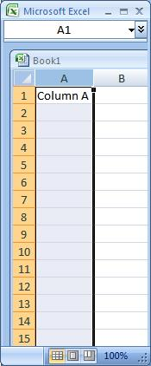
Excel Basics
Excel spreadsheets organize information (text and numbers) by rows and columns:
This is a row.
Rows are represented by numbers along the side of the sheet.
This is a column.
Columns are represented by letters across the top of the sheet.
Notes:
5

Slide 6
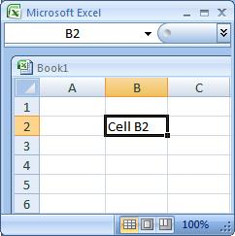
Excel Basics
A cell is the intersection between a column and a row.
Each cell is named for the column letter and row number that intersect to make it.
Notes:
6

Slide 7
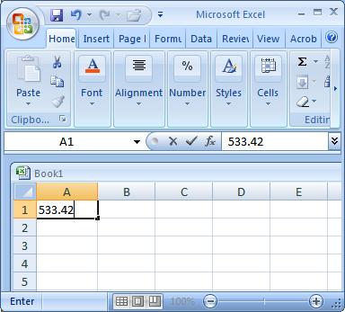
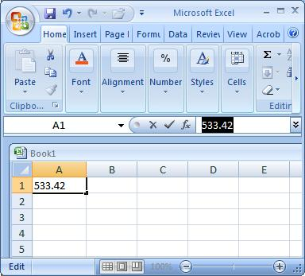
Data Entry
There are two ways to enter information into a cell:
1. Type directly into the cell.
Click on a cell, and type in the data (numbers or text) and press Enter.
2. Type into the formula bar.
Click on a cell, and then click in the formula bar (the space next to the ). Now type the data into the bar and press Enter.
Notes:
7

Slide 8
Excel Vocabulary
Workbook – An Excel File
Sheet – One page of an Excel file
Cell – one box within a sheet – every cell has both a column and row number: A1, A2, etc.
Formula bar – where data and/or formulas may be entered

Slide 9
Basic Skills
Entering Data
Sorting Data
Formatting
Autofill
Autosum
Inserting new rows and columns
Simple formulas
Saving and copying spreadsheet

Slide 10
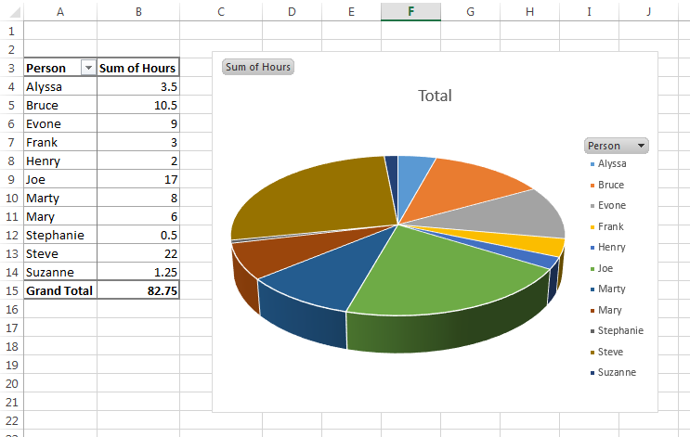
Advanced Skills (Not covered in this class)
Complex formulas
Charts and Graphs
Pivot tables
Statistical analysis

Slide 12
Additional Free Excel Training
Excel Easy: http://www.excel-easy.com/
Mr. Excel: http://www.mrexcel.com/
Excel Exposure: http://excelexposure.com/
Excel Tips: http://excelribbon.tips.net/
YouTube Channel of Excel tutorial videos:
https://www.youtube.com/user/contextures/videos

Slide 13
Additional Google Sheets Training
https://www.youtube.com/results?search_query=google+sheets+tutorial

Slide 14
If you get stuck… Just Ask Professor Google!

Slide 15
Let’s Get Started!

